Slide 1
Synthetic Occlusion Augmentation with Volumetric Heatmaps for 3D Human Pose Estimation
István Sárándi¹, Timm Linder², Kai O. Arras², Bastian Leibe¹
¹ Visual Computing Institute, RWTH Aachen University – Aachen, DE
² Robert Bosch GmbH, Corporate Research – Stuttgart, DE
September 8, 2018 – Munich, Germany
Updated: Sep 17, 2018

Slide 2
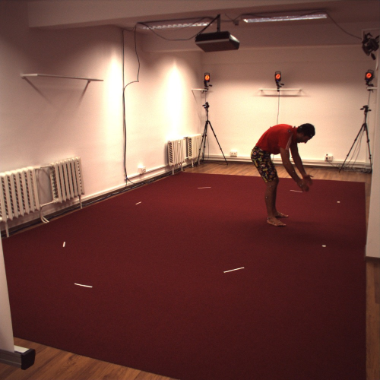
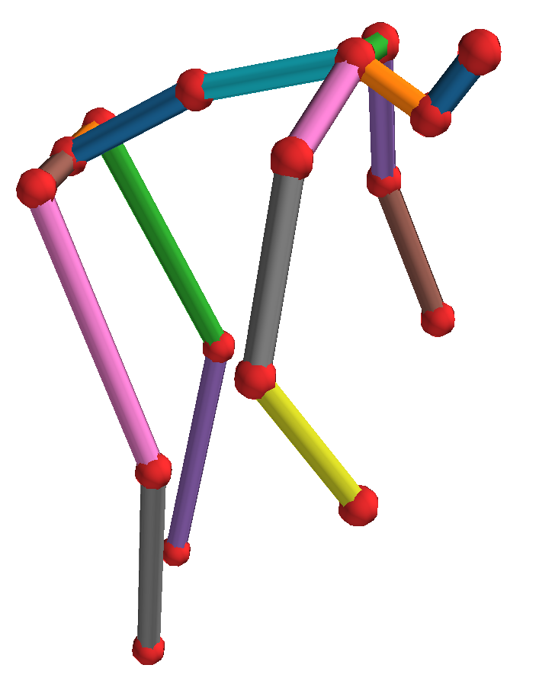
PoseTrack Challenge – 3D
[[ 0.0 0.0 0.0]
[ -96.9 -21.1 103.4]
[ -43.0 456.4 150.3]
[ 42.6 902.6 249.0]
[ 96.0 22.1 -102.8]
[ 91.0 508.3 -100.2]
[ 118.4 953.7 13.0]
[ 3.1 -262.6 13.2]
[ -36.6 -502.0 -72.2]
[ -96.7 -541.9 -162.8]
[ -88.0 -651.5 -140.0]
[ 85.4 -439.5 -131.1]
[ 278.0 -206.0 -121.3]
[ 367.3 28.3 -184.0]
[-139.0 -465.2 28.8]
[-406.6 -322.4 42.9]
[-414.1 -255.1 -202.1]]
pelvis
Notes:
In: uncropped, static RGB image of a single person
Out: 17 body joints in 3D camera space, relative to pelvis

Slide 3
Approach
Overall depth heatmap (1D)
0 meters
10 meters
Ground truth
1D heatmap head
1D soft
∗
L1
argmax
Z
loss
Detect
and
crop
Fully-conv
backbone
Back-project
Subtract
to 3D
root
x
i
pred.
3D heatmap head
3D soft
y
argmax
i
∆Z
i
Related:
Pavlakos, CVPR’17
Sun, ECCV’18
Notes:
Person detection precomputed with YOLOv3
ResNet-50v2 backbone
Estimate

Slide 4
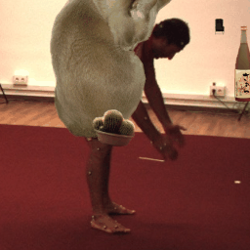
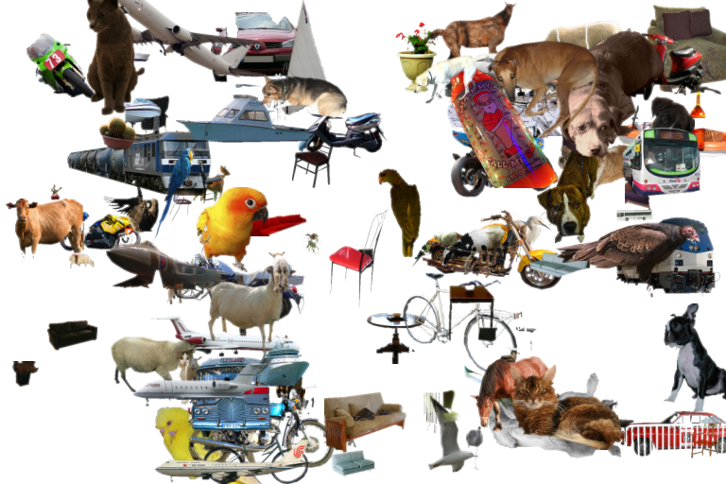
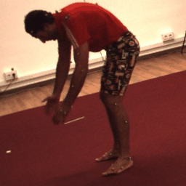
Synthetic Occlusions
Pascal VOC objects
+
geometry and color
=
Sárándi et al.: How robust is 3D human pose estimation to occlusion? arXiv:1808.09316, IROS’18 Workshops

Slide 5
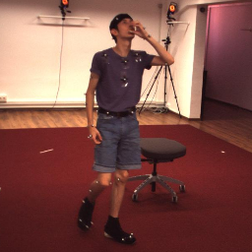
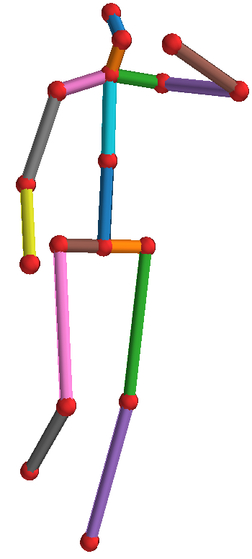
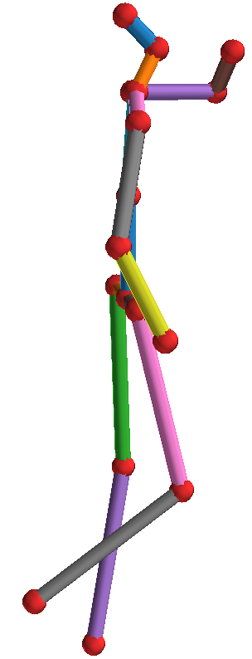
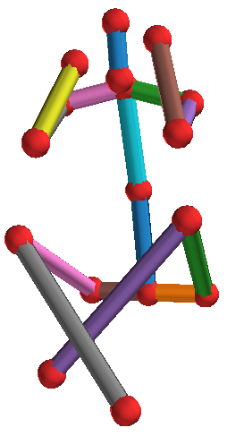
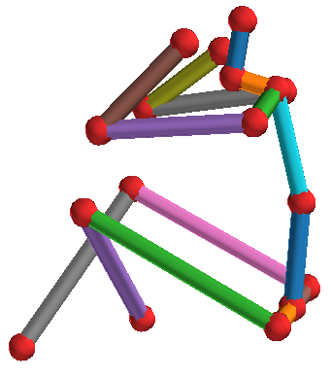
Results

Slide 6
Results

Slide 7
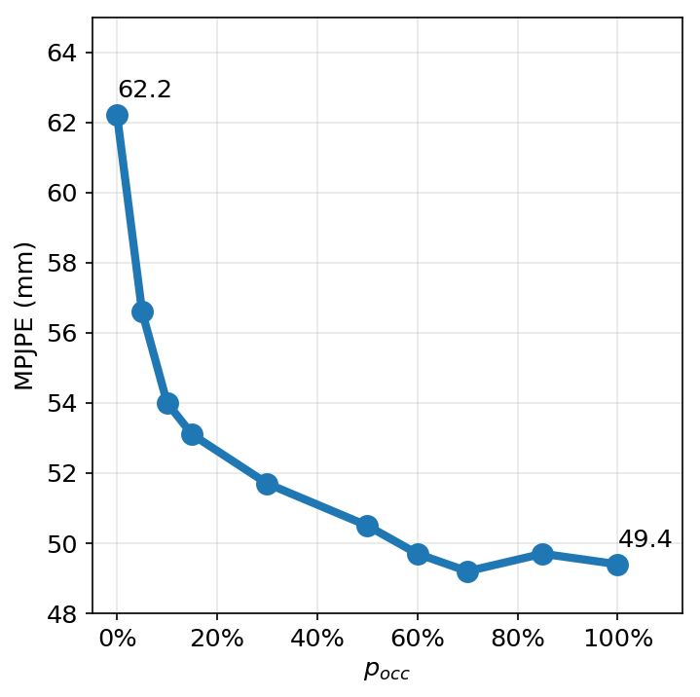
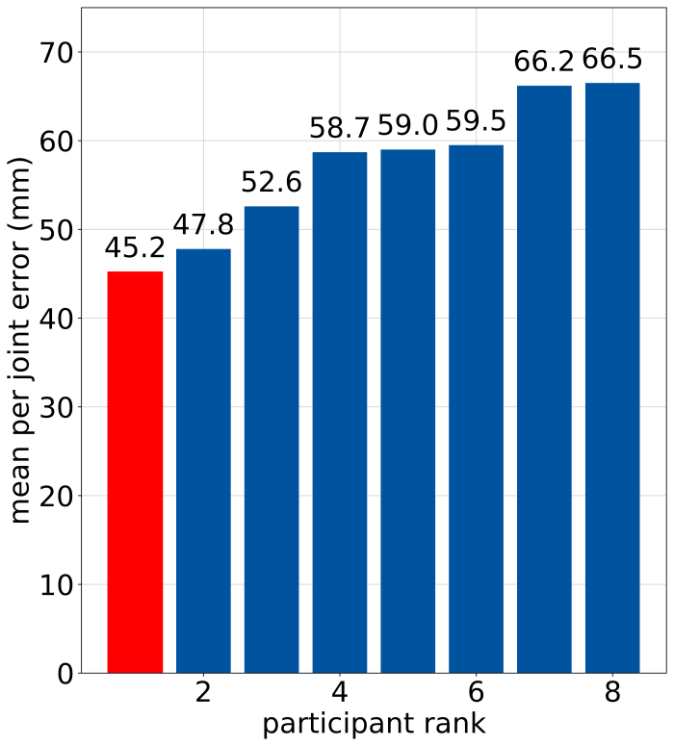
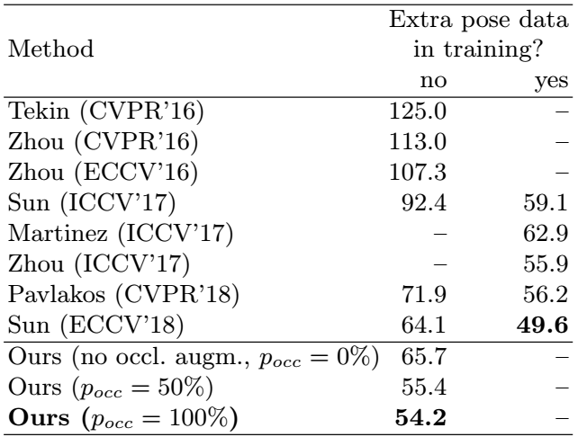
Results
1st place
in the Challenge
Best result on the full H3.6M
if no extra 2D pose datasets are used
Effect of occlusion augmentation
(evaluated on challenge validation set)

Slide 8
Conclusion
Human3.6M has little appearance variation
Overfitting → data augmentation helps
Simple, fast architecture, good performance
Heatmaps directly from backbone net
Soft-argmax on low-res heatmaps (16×16×16)
~200 fps inference (Titan X GPU, excl. detection)
1st place in 3D PoseTrack Challenge

Slide 9
Thank you!
sarandi@vision.rwth-aachen.de

